Slide 1
DATABASE OF BANK MANAGEMENT SYSTEM
Presented by:
Tanvir Ahmed
221002461

Slide 2
OUTLINES
Introduction
Features
System Description
Implementation
Output and Discussion
Future works
Conclusion

Slide 3

INTRODUCTION
The Bank Management System is a transformative software solution designed to revolutionize traditional banking operations.

Slide 4

FEATURES
Customer Management
Account Management
Transaction Processing
Security and Compliance
Loan Management

Slide 5
SYSTEM DESCRIPTION
Integrated Database Management
Efficient Transaction Processing
Customer Relationship Management
Security
Scalability and Adaptability
Reporting and Analytics

Slide 6
IMPLEMENTATION
Tables:
Customer -> 1000
Account -> 10000
Branch -> 20
Employee -> 200
Transaction -> 10000
Loan -> 500
Loan Payment -> 2000
Credit Card -> 1000
Credit Card Transaction -> 2000
ATM -> 100
ATM Transaction -> 1000
Manager -> 100
Service Request -> 500
Security -> 10000
Beneficiary -> 10000

Slide 7
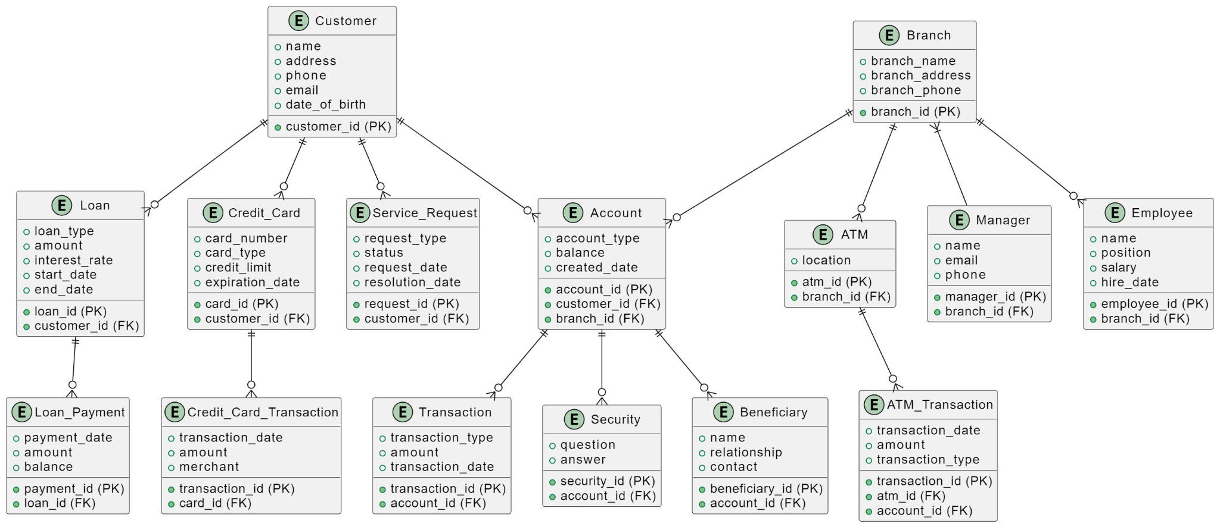
IMPLEMENTATION (cont.)

Slide 8
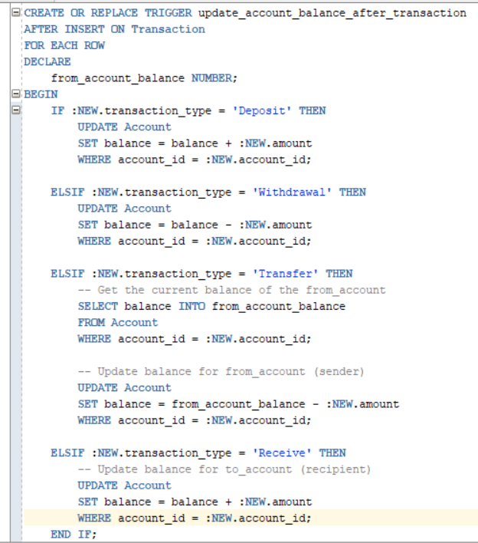
IMPLEMENTATION (cont.)

Slide 9
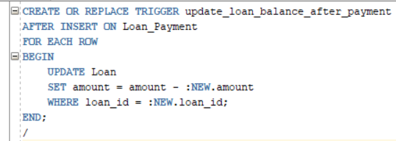
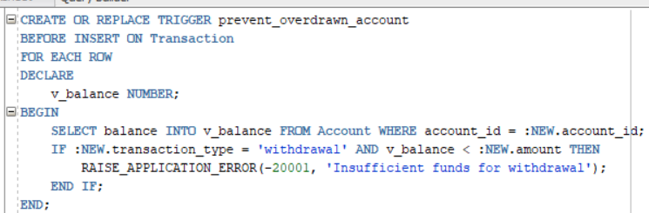
IMPLEMENTATION (cont.)

Slide 10
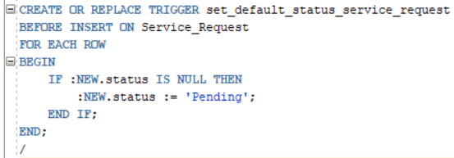
IMPLEMENTATION (cont.)

Slide 11
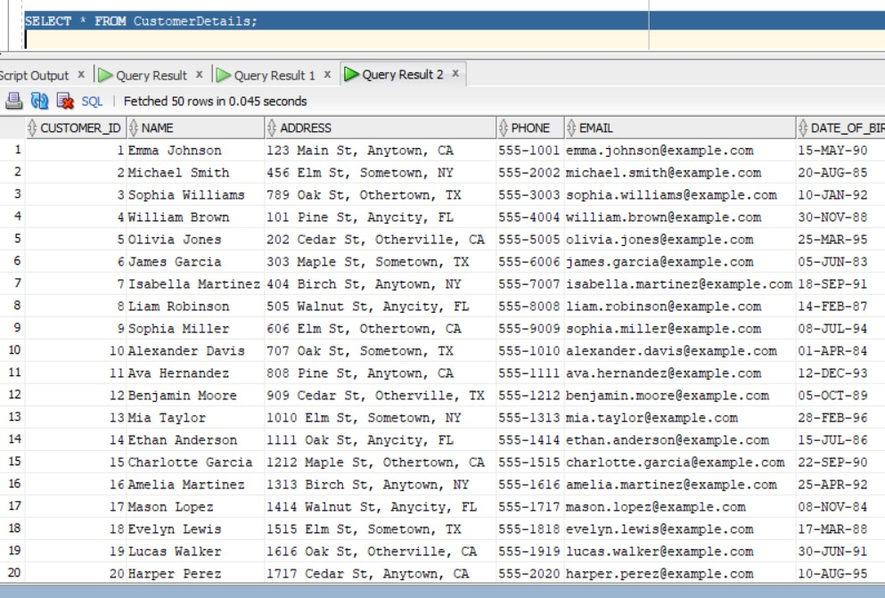
OUTPUT AND DISCUSSION

Slide 12
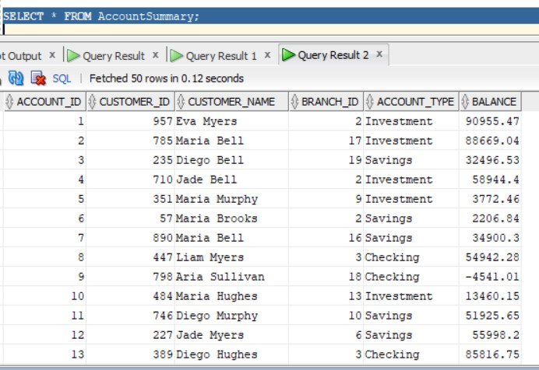
OUTPUT AND DISCUSSION

Slide 13
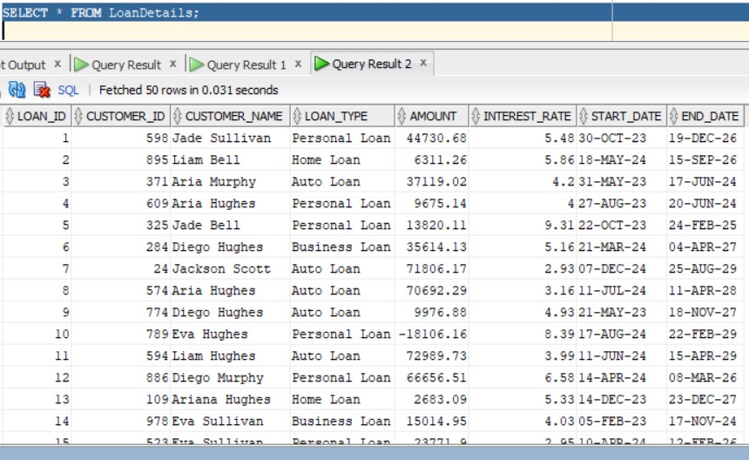
OUTPUT AND DISCUSSION

Slide 14
FUTURE WORKS
Enhanced Security Measures
Integration of AI and Machine Learning
Making the Database Capable of More Data Insertion
Expanded Data Analytics Capabilities
Blockchain for Transactions
Design a User Interface
Customer Experience Improvement

Slide 15
CONCLUSION
Achieved Project Goals
Enhanced Operational Efficiency
Improved Security Measures
Future Expansion Opportunities
Learning and Development
The Database of Bank Management System project lays a solid foundation for future advancements in banking technology, aiming to deliver enhanced customer service and operational excellence.

Slide 16
THANK YOU

